Slide 1
ASCEND as a step towards a CubeSat
Notes:
ASCEND as a step towards CubeSat
The ASCEND Program is being used to improve our capabilities significantly. Starting from shrinking electronics from large thruhole based designs to modern surface mount, and large carbon fiber boxes to a 2U cubesat-like structure. A new (freshman majority) team has also been built, who over the past year have learned many new technical skills with an emphasis on doing work correctly and to a high standard.

Slide 2
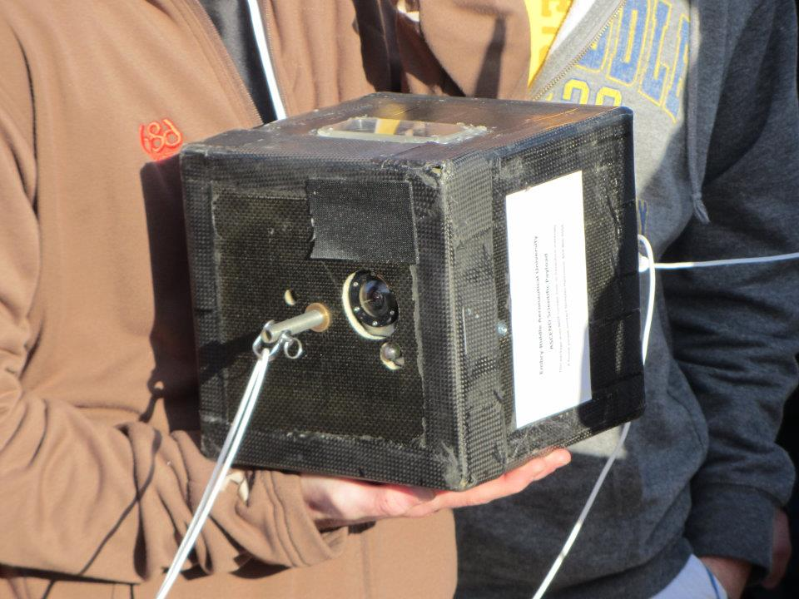
ASCEND program previously
Oversized for their task
No well defined goal
Primitive electronics

Slide 3
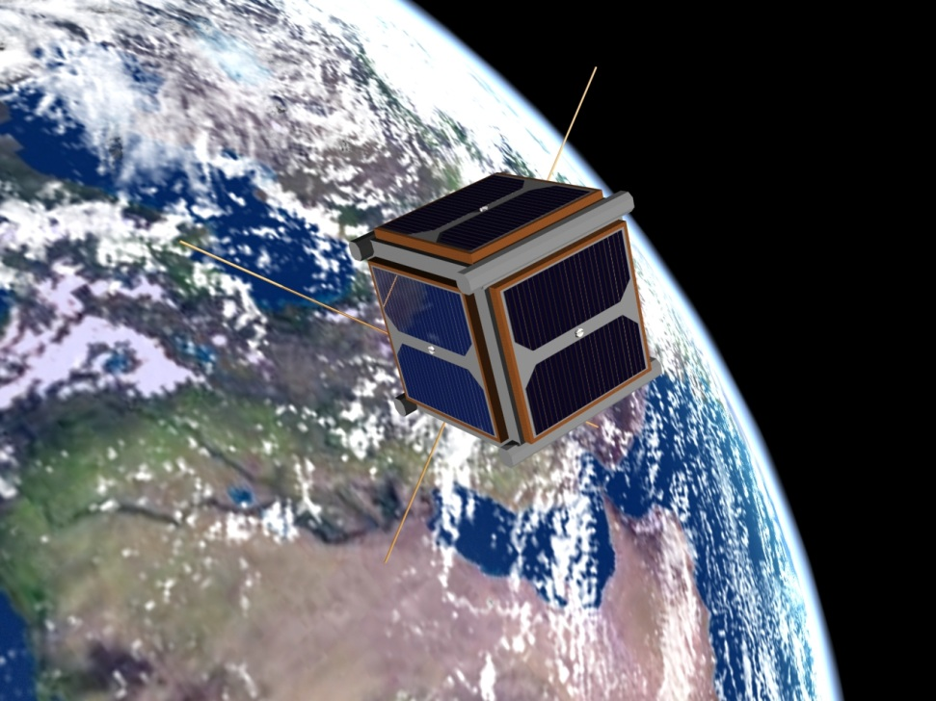
CubeSat Goal
10x10x10cm nanosat
Our mission: Software defined ADS-B receiver
Much more capability using modern components

Slide 4

New capabilities and Freshman Training
PCB workshop
  Basic PCB design
  Thru-hole soldering
  Surface mount (by hand and using our reflow oven)
Emphasis on quality and asking questions
Reliability testing

Slide 5
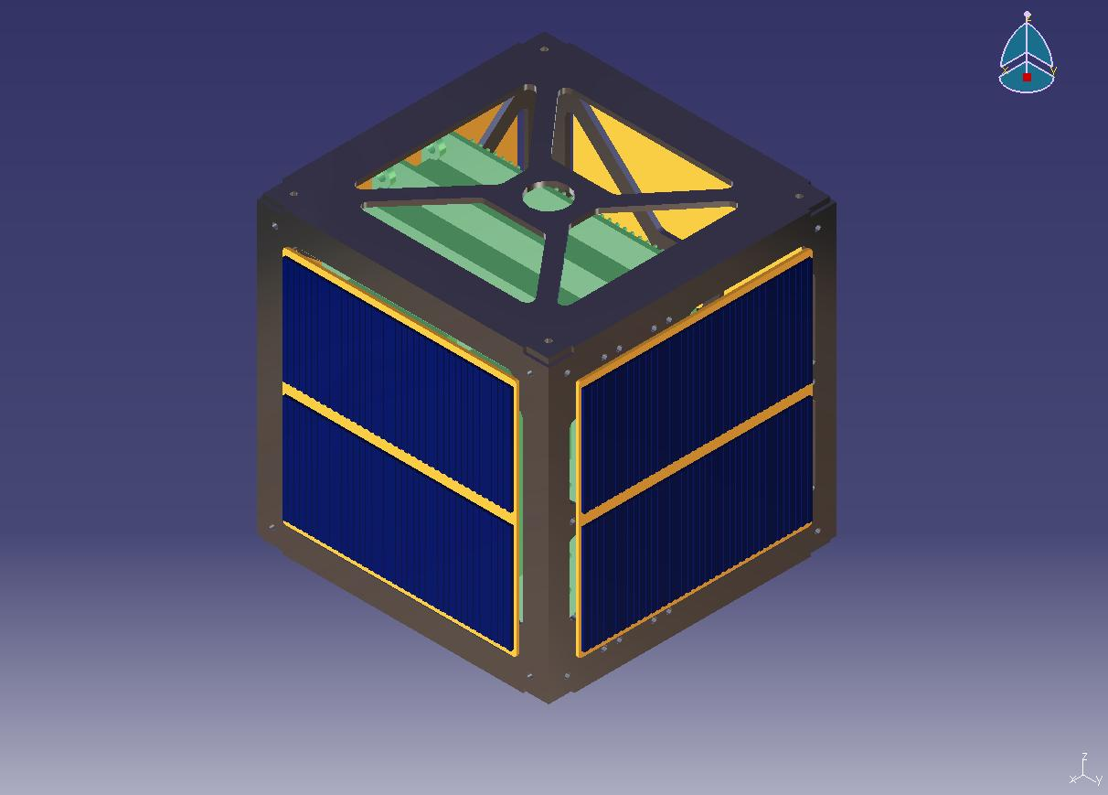
New Structures team
Working towards improving in-house machining and metal working ability
Used a basic CubeSat framework for the March 31 ASCEND flight
A new fully CubeSat compatible design currently being made for the next flight

Slide 6
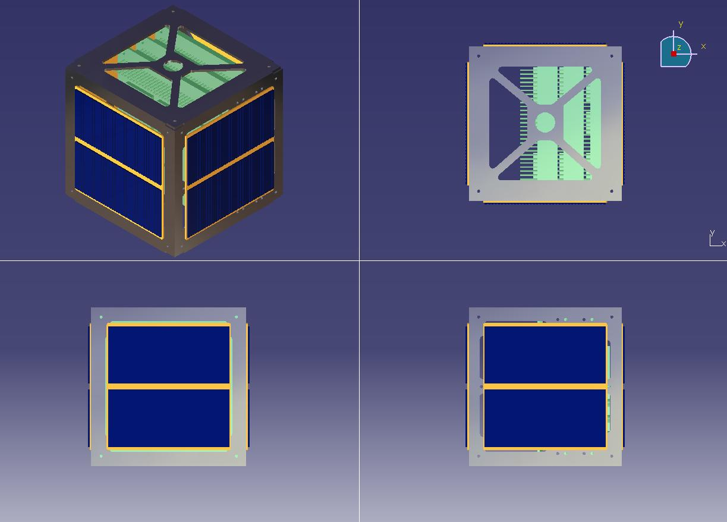

Slide 7
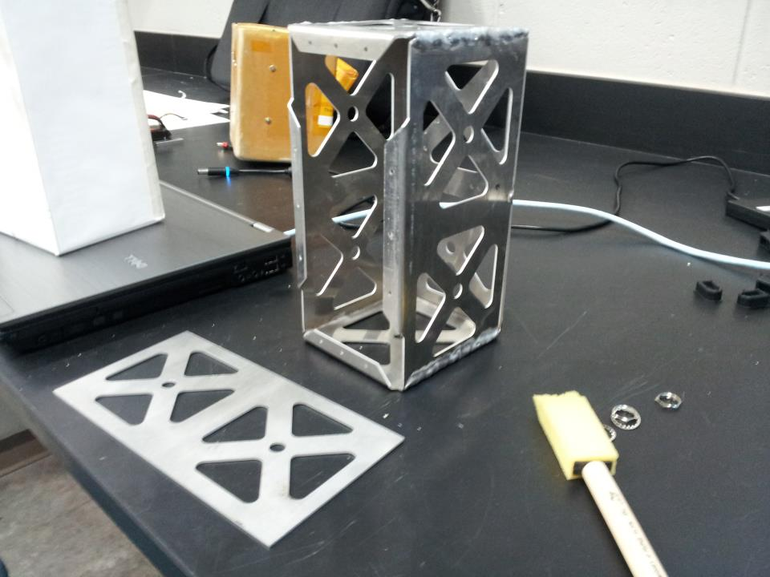

Slide 8
New Electronics design
0402 passive components
Live bidirectional telemetry (900mHz)
Custom pcbs for all new designs
PC104 physical standard
Photo of geiger pcb

Slide 9
Photo of radios

